Slide 1
Welcome to Induction
Computer Science, Information security and Math’s

Slide 2
Who we are
We’re a team consisting of 4 members of staff dedicated to supporting the computer Science, Mathematics and Information Security departments.
Narinder – CIM team lead
Francesco – Systems Administrator
Adrian – Systems Engineer
Claire – Systems Support

Slide 3
What we do
We offer support and advice specifically tailored to the computer Science, Information Security and Maths departments. This includes: (but is not limited to)
Maintaining the teaching labs in the Bedford building (0-04, 0-05, 0-06)
Infrastructure upgrades and hardware upgrades for the Bedford building
Event support for college-run events
Technical inductions and introductions for new students/staff to get them familiar with our system
Hardware provision and hardware support to the academics and researchers within the department

Slide 4
CIM Support - How to contact us
We are based in the lower Ground Bedford Building
Our Website https://cim.rhul.ac.uk/
If you have any technical problems or queries with any of our systems, by far the best way to get support is to raise a ticket on our helpdesk. Our helpdesk is monitored throughout the day and we tend to respond quickly. Our support hours are between 0900 and 1730 Monday to Friday, though we monitor the helpdesk and frequently respond to tickets outside of this time-frame.
Our helpdesk e-mail is: cimhelpdesk@rhul.ac.uk
You can also access our helpdesk and raise a ticket manually at
http://cimhelpdesk.rhul.ac.uk
we are not currently offering walk-up support from the office due to COVID-19, and to please make an appointment using the helpdesk

Slide 5
Documents and Guides
This page contains the links to documents and pages that are useful to those within the departments.
Linux connection guide: Linux Connection Guide
Coursework submission guide: Coursework Submission Guide
More information about Linux can be found here
Our main system is a Linux Terminal Server used by the students used by the students of Computer Science, Information Security, and Mathematics.
It is accessible 24-hours a day from both the Royal Holloway Labs and remotely from home or your University accommodation.
The only exception to this is during the university At-risk period, during which time the server may undergo maintenance.
The At-Risk period is scheduled from 7 AM to 10 AM every Tuesday.

Slide 6
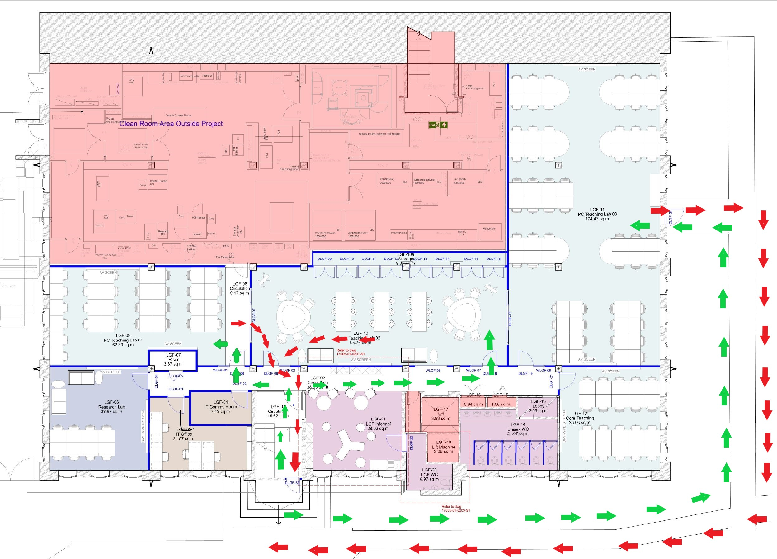
Lab Layout
0-05
0-06
0-04

Slide 7
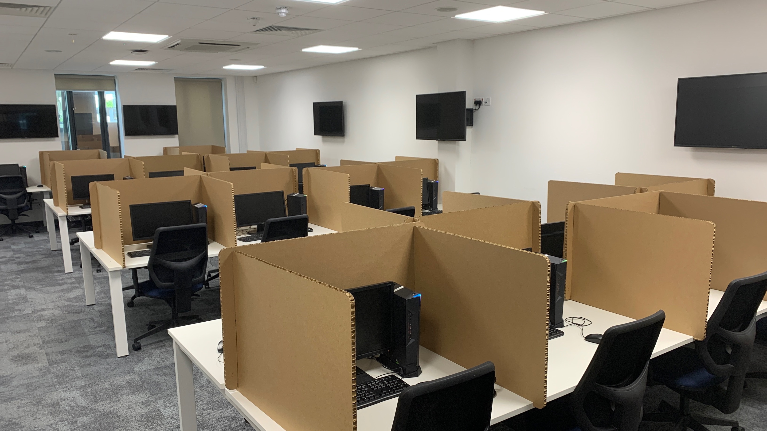
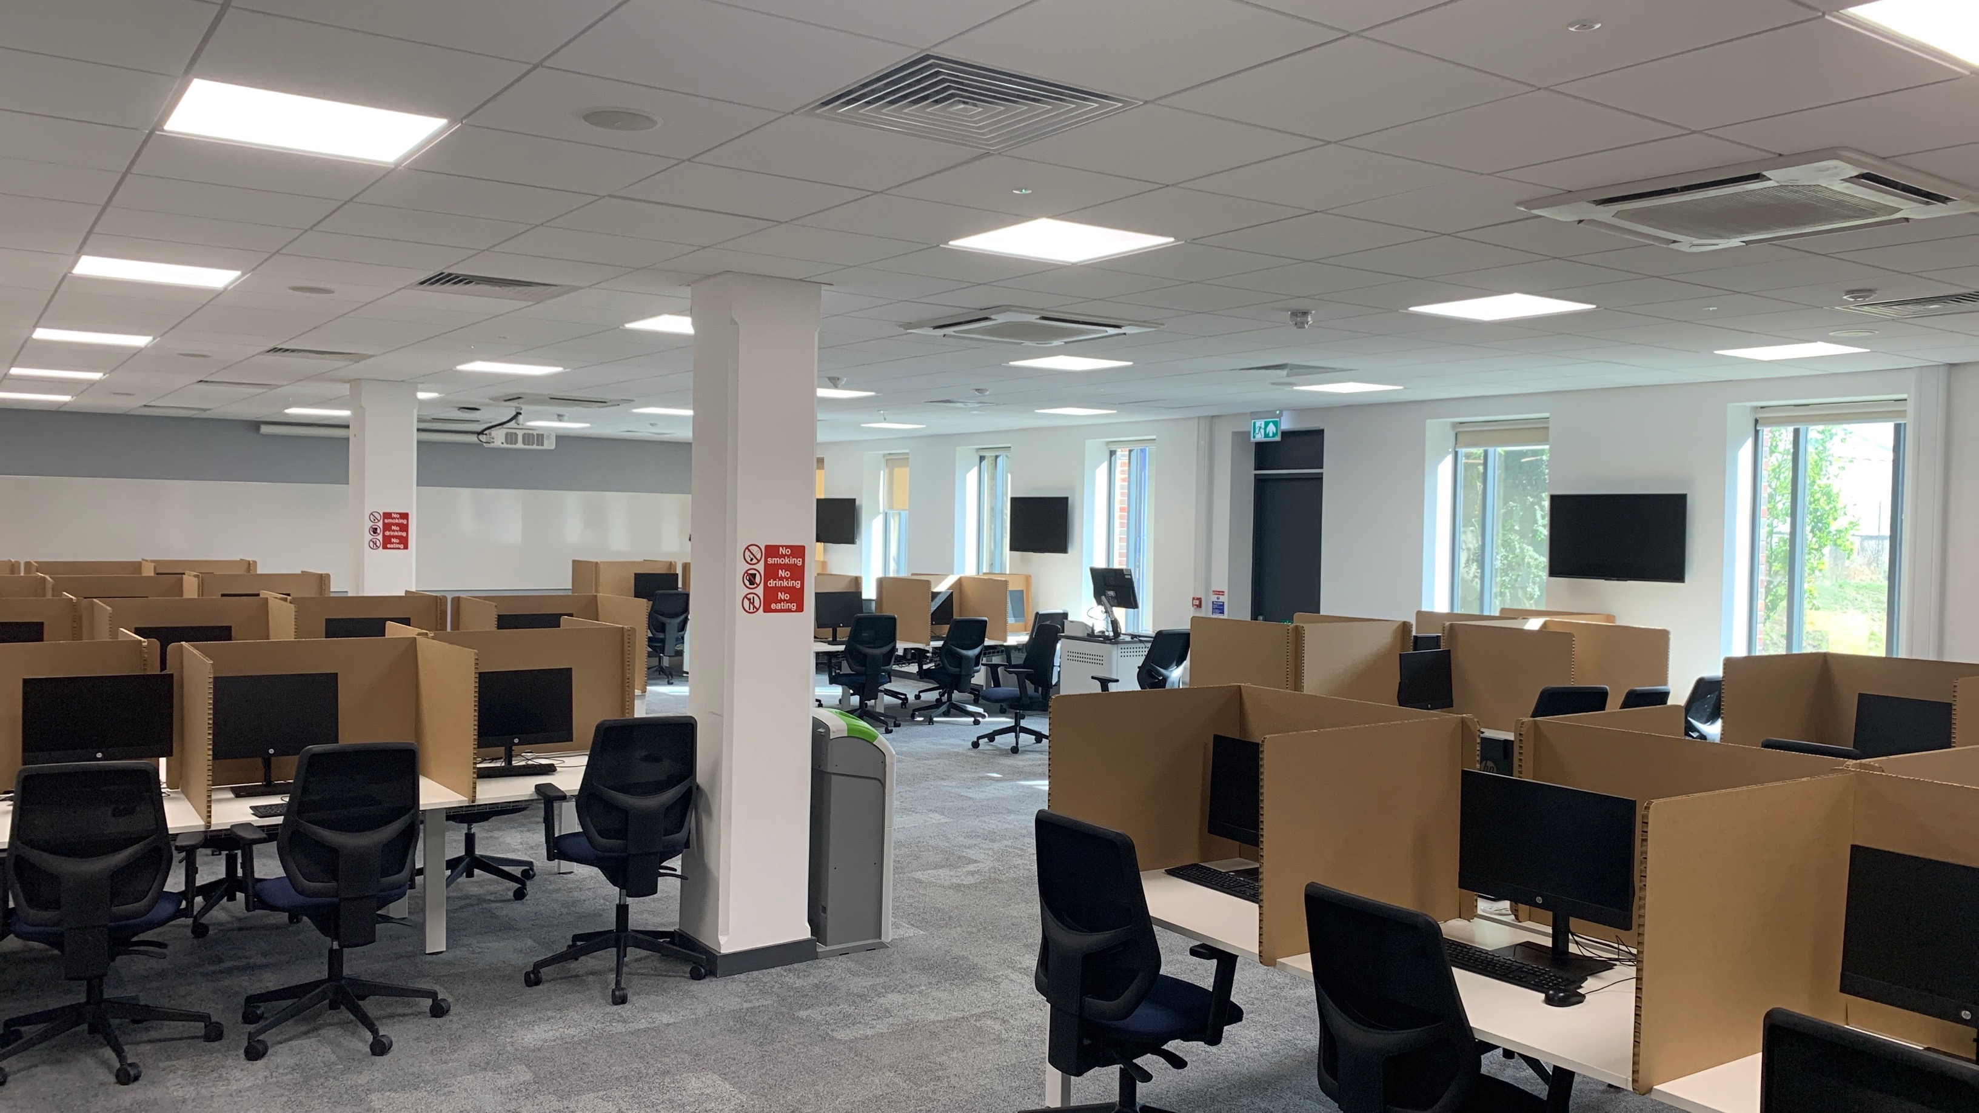
Lab Layout

Slide 8
Health And Safety Video
Video

Slide 9
User Account
Do you have you RHUL account login details?
Your username should be four letters / three digits (e.g: msai135)
Any issues with your user account, you need to contact IT Services
itservicedesk@rhul.ac.uk

Slide 10
Software
No Machine
Putty
MS Teams

Slide 11
Connecting to Linux Server
Accessing the terminal
There are multiple ways to access the Linux server, not all of which are command-line interfaces. We have a detailed guide on how to connect to the server in a few different ways here:
Click here for our connection guide.

Slide 12
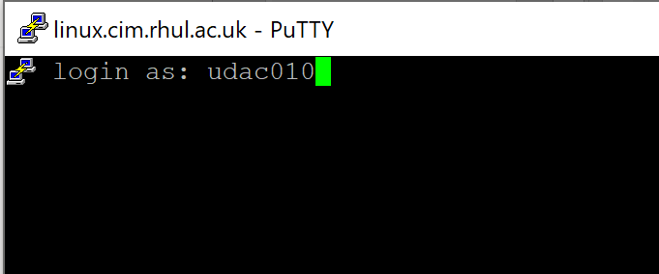
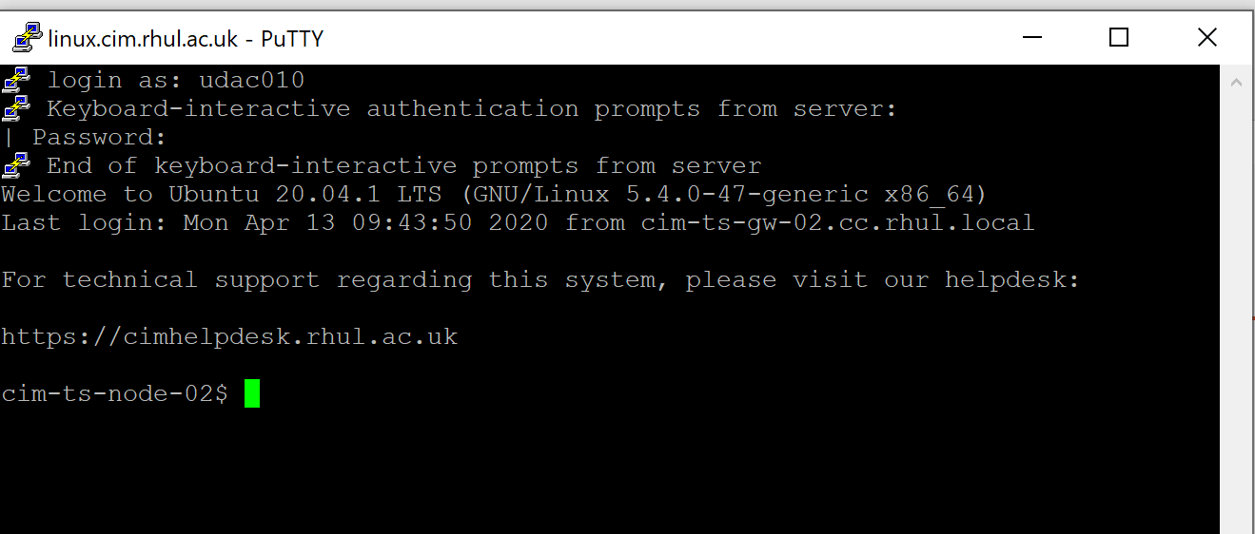
Connecting to Linux Server
Open Putty software
Enter the address as Linux.cim.rhul.ac.uk port 22
Enter Username
When you enter your password you will not see any activity , or any symbols * , # etc.

Slide 13
Using Command Line Interface - CLI
The following list contains a few of the commands that you can use to navigate the Linux server and perform your basic needs. Linux commands are all similar in how they are presented.
A command usually consists of the command itself (ls, cd, rm) and the parameters/arguments that the command requires. These parameters are different based on each command and will alter how the command functions.
cd (Change Directory)
The cd command is used to navigate linux servers and move between folders/directories.
cd on it’s own will return you to your /home directory.
cd .. moves you one directory upwards from your current location.
cd directory will move you into the specified folder/directory.

Slide 14
Using Command Line Interface - CLI
ls (List)
The ls command displays the files and folders that exist in your current location.
ls shows the names of files and folders in your current location, with colours indicating file type
ls -l shows more details information of the files/folders in your current location, showing information such as creation date and file size

Slide 15
Using Command Line Interface - CLI
cat (Catenate)
The cat command displays the contents of a file in text form, letting you read what’s inside a file without opening it completely.
cat file will show the file you’ve specified in the console as plain text.
cat -nfilewill show you the file in plain text with each line numbered, which can be helpful.

Slide 16
Using Command Line Interface - CLI
cp (Copy/Paste)
The cp command is the Linux equivalent of copy/paste functionality.
cp file destination will copy the file in the specified location to the specified destination.
cp -b file destination copies the specified file to the specified location and creates a backup named ~destination.
cp -i file destination copies the specified file to the specified destination and prompts for permission if overwriting a file.

Slide 17
Using Command Line Interface - CLI
mkdir (Make Directory)
The mkdir command creates a new folder and names it however you specify.
mkdir directory creates a new folder in your current location and names it after your input for directory.
SSH (Secure Shell Protocol)
ssh is a protocol that allows connections to other servers and locations that forces certain certificate procedures to make the connection secure.
ssh username@destination connects to the specified server with the given username.

Slide 18
Using Command Line Interface - CLI
rm (Remove)
The rm command is used to delete files and folders/directories.
rm file will give you a prompt to delete the specified file, confirm by inputting y (y is yes, n is no). It will fail to delete a Folder/Directory.
rm -r folder gives you a prompt to delete the specified file or directory.
rm -rf file/folder deletes the specified file or folder without prompting, be very careful using this!

Slide 19
Using Command Line Interface - CLI
Submitting Coursework from the command line
Knowing how to submit the work you’ve done for your courses is a vital piece of information that you’ll need to get to grips with.
The following is a short rundown of how the process of submitting coursework should go:
Firstly connect to the linux server with PuTTY or log in to NoMachine.
When you’re connected to the linux server, create the directory that will contain your coursework (mkdir courseworkDirectory)
When you’ve created your folder, use the ls command to check that you can see the new directory. (ls or ls -l)
put your coursework into the newly created directory. This can be done by clicking and dragging to the folder in NoMachine or using the cp command from the command line. (cp sourceDirectory destinationDirectory)
After you’ve checked that you can see the directory and your files inside it, run submitCoursework and point it towards your coursework directory (submitCoursework courseworkDirectory).
If you’ve done it correctly, you’ll receive a message asking you to enter your Course Code and in some instances you’ll need to enter your university password.

Slide 20
Links
https://cim.rhul.ac.uk/
https://cimhelpdesk.rhul.ac.uk/
https://linux.cim.rhul.ac.uk/nxwebplayer
SSH - Linux.cim.rhul.ac.uk Port 22

